Slide 1

DATABASE MANAGEMENT SYSTEMS
HOTEL
MANAGEMENT
SYSTEM
A robust relational model for bookings,
room inventory, payments & auditing
MySQL Project • DBMS Laboratory
PROJECT ALLOCATION
TEAM 15
3 COLLABORATORS
Ganapathiraju Venkata Atchutha Ramaraju,
Ganta Yasaswini, Boyina Kundana Venkata Sai
HOSPITALITY • RESERVATIONS • PAYMENTS • AUDITING
TEAM 15 • HOTEL MANAGEMENT SYSTEM
01 / 13

Slide 2
Introduction & Project Objectives
Hotel Management System • Project Overview
WHAT IS THE HOTEL MANAGEMENT SYSTEM (HMS)?
A centralized, relational software system implemented on MySQL (database: hotel_management) designed to digitally administer guest profiles, real-time room inventory, multi-date reservations, financial payments, and front-desk check-in/out lifecycles.
Goal:
Give hotel administrators and receptionists a single, synchronized source of truth for hospitality operations.
01
Customer Registry
02
Room Types
03
Room Inventory
04
Booking Engine
05
Payment Ledger
Captures contact records, address, DOB, and verified government ID credentials.
Lookup catalog for Single, Double, Deluxe, Suite, and Family configurations.
Tracks floor numbers, AC status, pricing tiers, and maintenance routines.
Manages arrival/departure schedules with automated night & tariff calculation.
Tracks UPI, Card, Net Banking & Cash transactions with gateway references.
ONE SOURCE OF TRUTH
Guests → Rooms → Bookings → Payments → Operations
TEAM 15 • HOTEL MANAGEMENT SYSTEM
02 / 13

Slide 3
Problem Statement & Solution
Hotel Management System • Problem Analysis & Solution
Bottom line: the relational MySQL database eliminates paper-based errors, automates bill calculation via triggers, and guarantees data consistency at all times.
EXISTING CHALLENGES
PROPOSED RELATIONAL SOLUTION
Double Booking Conflicts: Overlapping manual entries on physical ledgers assign identical rooms to multiple guests.
Strict Referential Integrity: Foreign key constraints (ON DELETE RESTRICT) prevent orphaned booking records.
Billing & Tariff Inaccuracies: Manual calculation of multi-night stays and room rates introduces human error.
Automated Triggers: before_booking_insert dynamically evaluates DATEDIFF() * Price_Per_Night.
Untracked Room Conditions: Reception lacks instant status on rooms currently Available, Occupied, or under Maintenance.
Third Normal Form (3NF): Room specifications isolated in room_types to eliminate update anomalies.
Payment Disconnect: Separate billing slips cause unrecorded balances and difficulty tracking payment modes (UPI/Card).
ACID-Compliant Transactions: Multi-mode financial transactions logged with unique reference validation.
TEAM 15 • HOTEL MANAGEMENT SYSTEM
03 / 13

Slide 4
System Architecture & Data Flow
The hotel workflow follows the entity lifecycle from guest registration to payment clearing and check-out auditing.
01
02
03
04
05
CUSTOMERS
ROOM_TYPES
ROOMS
BOOKINGS
PAYMENTS / OPS
Personal info, DOB,
city & ID proof
Single, Deluxe, Suite,
Bed Type & AC
Floor, view type,
maintenance dates
Stay dates, guest count,
total amount trigger
UPI/Card + check-in/
check-out timestamps
BOOKING & TARIFF CALCULATION
PAYMENT CONFIRMATION & DEPARTURE
When a booking is scheduled, MySQL triggers query Price_Per_Night from rooms and multiply it by calculated nights (Check_Out_Date - Check_In_Date).
Successful payment entries switch reservation status to 'Confirmed', while front desk arrival is stamped inside the check_in_out audit relation.
TEAM 15 • HOTEL MANAGEMENT SYSTEM
04 / 13

Slide 5
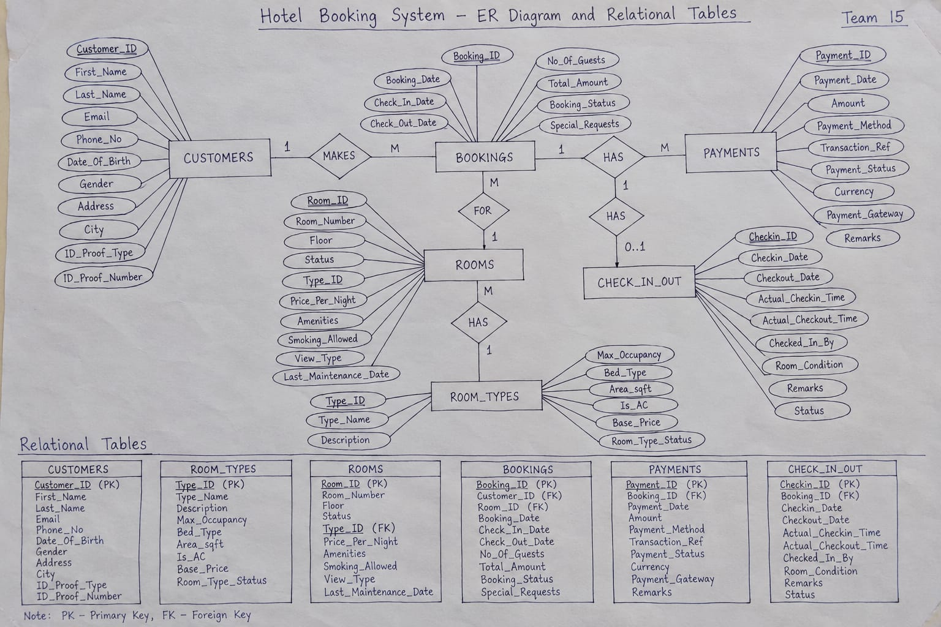

Slide 6
Entity-Relationship (ER) Diagram
TEAM 15 PROJECT ARTIFACT • HOTEL BOOKING SYSTEM ER MODEL & RELATIONAL TABLES
Entity
Relationship
PK
FK
Customers
Room_Types
Rooms
MAKES • 1:N
HAS • 1:N
Customer_ID (PK)
Type_ID (PK)
Room_ID (PK)
Names • Contact • Address
Bed Type • Max Occupancy
Room No • Floor • Status
DOB • ID Proof
Area sqft • AC • Base Price
View Type • Type_ID (FK)
FOR • 1:N
HAS • 1:N
HAS • 0..1
Bookings
Payments
Check_In_Out
Booking_ID (PK)
Payment_ID (PK)
Checkin_ID (PK)
Customer_ID • Room_ID (FK)
Booking_ID (FK)
Booking_ID (UNIQUE)
Check-In/Out • Guests • Total
UPI • Card • Net Banking
Arrival / Departure log
Rectangles = 6 relational entities • Relationships = 5 • Underlined = PK • Italics = FK • Mappings: 1:N, M:1, 1:0..1
TEAM 15 • HOTEL MANAGEMENT SYSTEM
05 / 13

Slide 7
ER Diagram: Structure & Relations
Hotel Management System • ER Diagram Explanation
6 CORE RELATIONAL ENTITIES
CARDINALITY & RELATIONSHIP LOGIC
1. CUSTOMERS
CUSTOMERS (1) — MAKES — (M) BOOKINGS: A single customer can reserve rooms multiple times across different dates; each booking points to exactly one primary guest.
Stores primary guest identities: Customer_ID (PK), names, contact numbers, address, and government ID proof (Aadhar/Passport).
2. ROOM_TYPES
ROOM_TYPES (1) — HAS — (M) ROOMS: Each room type (e.g. Deluxe) categorizes multiple physical rooms, enforcing 3NF by preventing specification duplication.
Master catalog defining category tiers: Type_ID (PK), Bed Type, Max Occupancy, Area sqft, AC status, and Base Price.
3. ROOMS
ROOMS (1) — FOR — (M) BOOKINGS: A physical room can be scheduled for multiple separate bookings over time without overlapping reservation intervals.
Physical inventory units: Room_ID (PK), Room Number, Floor, Status, View Type, and Type_ID (FK) link to catalog.
4. BOOKINGS
BOOKINGS (1) — HAS — (M) PAYMENTS: Supports flexible accounting—allowing guests to submit advance tokens, partial payments, or multi-mode settlements.
Central transaction junction: Booking_ID (PK), Check-In/Out dates, guest count, and dynamic Total Amount.
BOOKINGS (1) — HAS — (0..1) CHECK_IN_OUT: A unique 1-to-0..1 relationship. A booking exists prior to physical arrival, receiving exactly one check-in audit log.
5 & 6. PAYMENTS / CHECK_IN_OUT
Tracks multi-gateway settlements (UPI, Card, Net Banking) and logs real-time arrival/departure operational timestamps.
Design validation: fully eliminates data redundancy while maintaining strict referential integrity.
TEAM 15 • HOTEL MANAGEMENT SYSTEM
06 / 13

Slide 8
Relational Schema & Keys
Hotel Management System • Keys & Relationships
RI
Referential Integrity Constraints
PK
Surrogate Key Standard
Configured with ON UPDATE CASCADE and ON DELETE RESTRICT on all foreign keys to safeguard against accidental deletion of active guest stays or historical payments.
Auto-incrementing integer primary keys (AUTO_INCREMENT) ensure high-performance joins and prevent key instability across all 6 core relations.
RELATIONAL TABLE
PRIMARY KEY (PK)
FOREIGN KEY (FK)
REFERENCED TABLE
CARDINALITY
CUSTOMERS
Customer_ID
None (Independent)
—
1 : N with BOOKINGS
ROOM_TYPES
Type_ID
None (Catalog)
—
1 : N with ROOMS
ROOMS
Room_ID
Type_ID
ROOM_TYPES (Type_ID)
M : 1 with ROOM_TYPES
BOOKINGS
Booking_ID
Customer_ID, Room_ID
CUSTOMERS, ROOMS
M : 1 for both parents
PAYMENTS
Payment_ID
Booking_ID
BOOKINGS (Booking_ID)
1 : N (Installments/Advance)
CHECK_IN_OUT
Checkin_ID
Booking_ID (UNIQUE)
BOOKINGS (Booking_ID)
1 : 0..1 (Single Stay Log)
TEAM 15 • HOTEL MANAGEMENT SYSTEM
07 / 13

Slide 9
Normalization & Constraints
Hotel Management System • Normalization & Constraints
NORMALIZATION PROGRESSION
APPLIED CONSTRAINTS IN SQL
Atomic attributes
✓
CHECK (Check_Out_Date > Check_In_Date): Enforces valid stay periods.
1NF
All attributes are atomic. Singular phone numbers, distinct first/last names, and atomic date values eliminate multivalued repeating columns.
✓
CHECK (Gender IN ('Male','Female','Other')): Validates customer gender domain.
Full dependency
✓
CHECK (Status IN ('Available','Occupied','Maintenance')): Room lifecycle.
2NF
Eliminated partial functional dependencies. Since all tables use single-column primary keys, all non-key attributes depend fully on the primary key.
✓
CHECK (Payment_Method IN ('Cash','Card','UPI','Net Banking')): Verified modes.
No transitive dependency
3NF
Removed transitive dependencies. Room category specifications (Bed_Type, Is_AC, Base_Price) reside in room_types, avoiding redundancy in rooms.
✓
UNIQUE: Enforced on Email, Phone_No, ID_Proof_Number, Transaction_Ref.
✓
NOT NULL: Mandatory names, room numbers, booking dates, and amounts.
TEAM 15 • HOTEL MANAGEMENT SYSTEM
08 / 13

Slide 10
MySQL Implementation & CRUD
Hotel Management System • MySQL Schema & CRUD
DDL SCHEMA DEFINITION
CRUD OPERATIONS
DATABASE + BOOKINGS TABLE
CREATE (INSERT)
CREATE DATABASE hotel_management;
USE hotel_management;
CREATE TABLE bookings (
Booking_ID INT PRIMARY KEY AUTO_INCREMENT,
Customer_ID INT NOT NULL,
Room_ID INT NOT NULL,
Check_In_Date DATE NOT NULL,
Check_Out_Date DATE NOT NULL,
Booking_Date DATE NOT NULL DEFAULT CURRENT_DATE,
Guest_Count INT NOT NULL,
Total_Amount DECIMAL(10,2),
Status VARCHAR(20) DEFAULT 'Confirmed',
FOREIGN KEY (Customer_ID) REFERENCES customers(Customer_ID),
FOREIGN KEY (Room_ID) REFERENCES rooms(Room_ID)
);
Inserts guests (customers), rooms, bookings, and multi-gateway payments (payments).
READ (SELECT)
Retrieves available rooms, filters by city/price, and queries active reservations via WHERE.
UPDATE
Modifies room prices (e.g. Price_Per_Night = 2200) and status upon guest check-in.
DELETE (Safe Handling)
Guarded by RESTRICT to protect audit histories of customers with existing bookings.
TEAM 15 • HOTEL MANAGEMENT SYSTEM
09 / 13

Slide 11
SQL Queries & Complex Joins
Hotel Management System • Joins & Subqueries
MASTER REPORT QUERY
RELATIONAL OPERATIONS APPLIED
-- Comprehensive Booking & Room Type Master Report
SELECT
CONCAT(c.First_Name, ' ', c.Last_Name) AS Customer_Name,
b.Booking_ID, r.Room_Number, rt.Type_Name,
b.Check_In_Date, b.Check_Out_Date, b.Total_Amount
FROM bookings b
INNER JOIN customers c ON b.Customer_ID = c.Customer_ID
INNER JOIN rooms r ON b.Room_ID = r.Room_ID
INNER JOIN room_types rt ON r.Type_ID = rt.Type_ID;
INNER JOIN
Connects 4 tables simultaneously to generate customer billing schedules.
LEFT JOIN
Identifies registered customers who have not placed any reservation yet.
Aggregate Functions
Evaluates SUM(Total_Amount), AVG(Price_Per_Night), and COUNT(*).
Subquery Filters
Queries rooms costing above average price using WHERE Price_Per_Night > (SELECT AVG(...) FROM rooms).
HAVING Clause
Flags VIP customers who spent more than average booking value.
TEAM 15 • HOTEL MANAGEMENT SYSTEM
10 / 13

Slide 12
Automated Triggers & Functions
Hotel Management System • Automated Triggers
01
before_booking_insert
02
after_payment_insert
Eliminates human tariff calculation errors by multiplying night duration by the room rate prior to database insertion.
Automatically switches booking status from pending to 'Confirmed' the moment full payment is successfully logged.
TRIGGER 01 • TARIFF CALCULATION
TRIGGER 02 • PAYMENT CONFIRMATION
DELIMITER //
CREATE TRIGGER before_booking_insert
BEFORE INSERT ON bookings
FOR EACH ROW
BEGIN
DECLARE room_rate DECIMAL(10,2);
SELECT Price_Per_Night INTO room_rate
FROM rooms WHERE Room_ID = NEW.Room_ID;
SET NEW.Total_Amount =
DATEDIFF(NEW.Check_Out_Date, NEW.Check_In_Date) * room_rate;
END//
DELIMITER ;
DELIMITER //
CREATE TRIGGER after_payment_insert
AFTER INSERT ON payments
FOR EACH ROW
BEGIN
IF NEW.Payment_Status = 'Completed' THEN
UPDATE bookings
SET Status = 'Confirmed'
WHERE Booking_ID = NEW.Booking_ID;
END IF;
END//
DELIMITER ;
TEAM 15 • HOTEL MANAGEMENT SYSTEM
11 / 13

Slide 13
Advanced Database Features
The implementation extends beyond standard tables by incorporating high-performance enterprise features from hotel_management_sys.sql.
VIEW
PROC
UDF
SQL Views
Stored Procedures
UDF Functions
available_rooms and booking_report provide instant joined summaries for front-desk reception.
GetAvailableRooms(), GetCustomerBookings(), and AddCustomer() encapsulate business logic.
CalculateNights() and CalculateBookingCost() dynamically derive total stay cost for any dates.
ACID
INDEX
ACID Transactions
B-Tree Indexes
START TRANSACTION, COMMIT, and ROLLBACK protect room allocation atomicity.
Created on idx_customer_email, idx_booking_dates, and idx_room_status for instant query lookups.
TEAM 15 • HOTEL MANAGEMENT SYSTEM
12 / 13

Slide 14
Business Reports & Conclusion
CONCLUSION
Hotel Management System • Project Conclusion
6
Normalized 3NF Tables
3
Active SQL Triggers
6
High-Speed Indexes
100%
ACID Transactional Safety
KEY OPERATIONAL REPORTS
QUESTIONS & DISCUSSION
Revenue by Payment Mode
Totals collected via UPI, Razorpay cards, and net banking.
“A well-designed relational database structure removes operational redundancy and ensures 100% data integrity for hotel management.”
Room Category Occupancy
Total bookings and earnings grouped across Suite, Deluxe, Double, Single.
Current In-House Guests
Filtered via check_in_out.Status = 'Checked-In' for real-time headcount.
Thank you
TEAM 15 • HOTEL MANAGEMENT SYSTEM
13 / 13

